Slide 1
Pop Verse
Funko Pop Marketplace
Helene Olivares
Diego Araneda

Slide 2
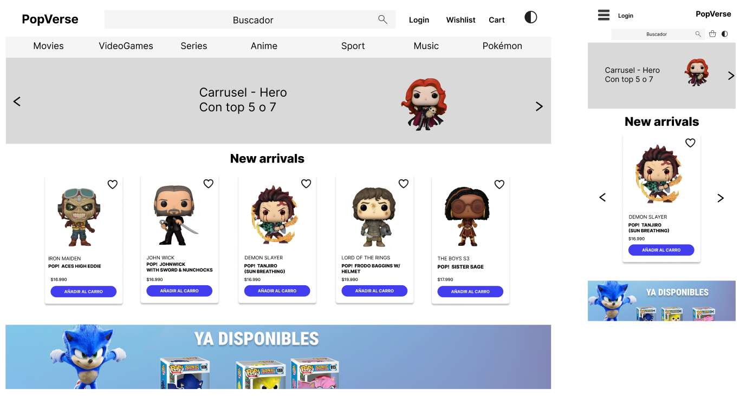
Screenshots - Home

Slide 3
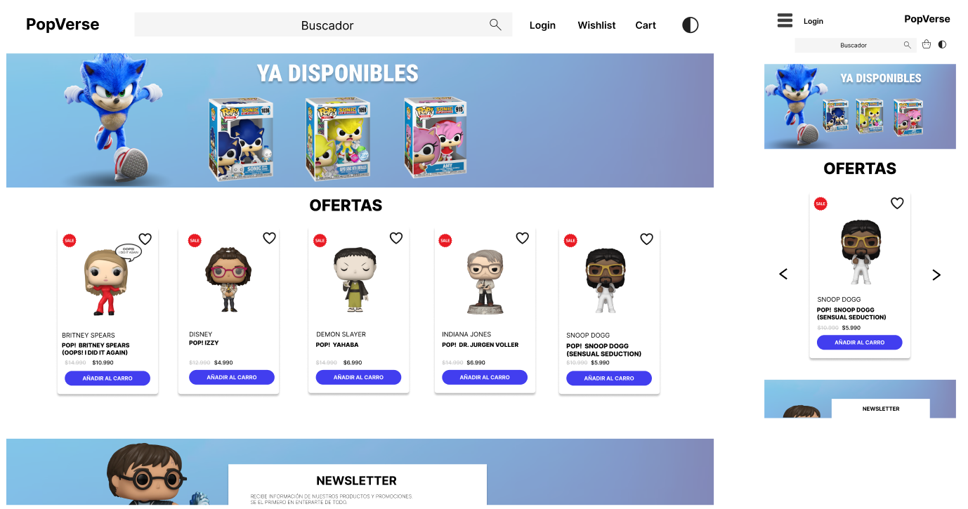
Screenshots - Home

Slide 4
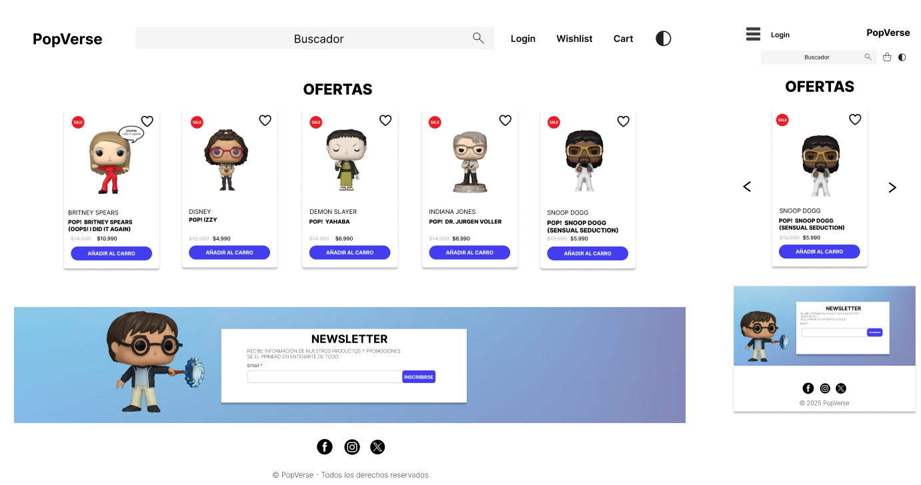
Screenshots - Home

Slide 5
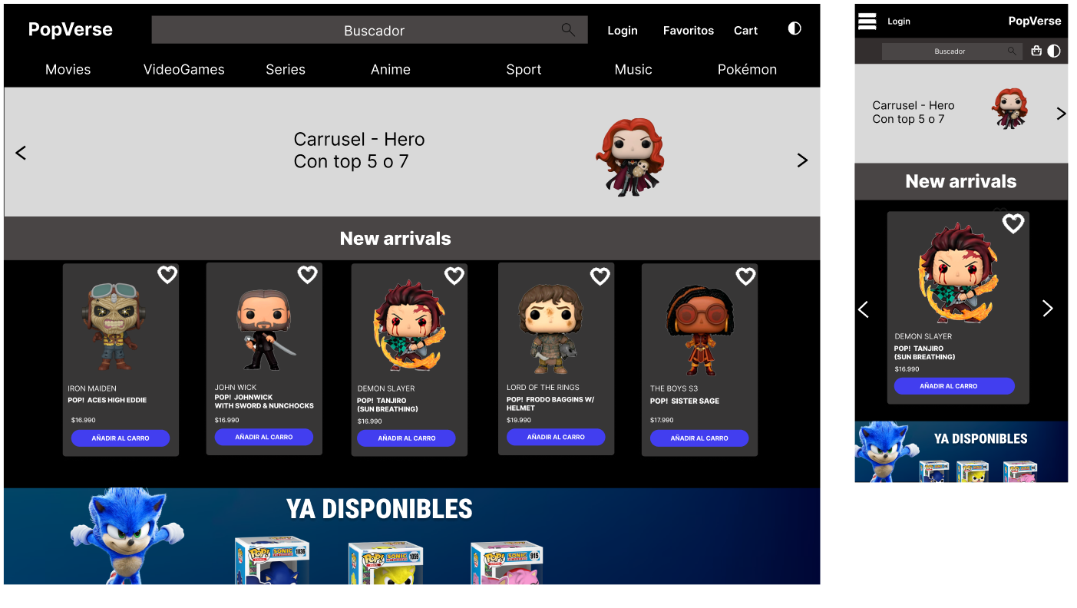
Screenshots - Home (Dark Mode)

Slide 6
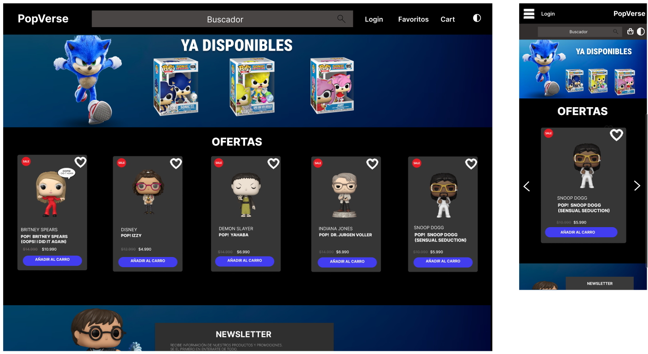
Screenshots - Home (Dark Mode)

Slide 7
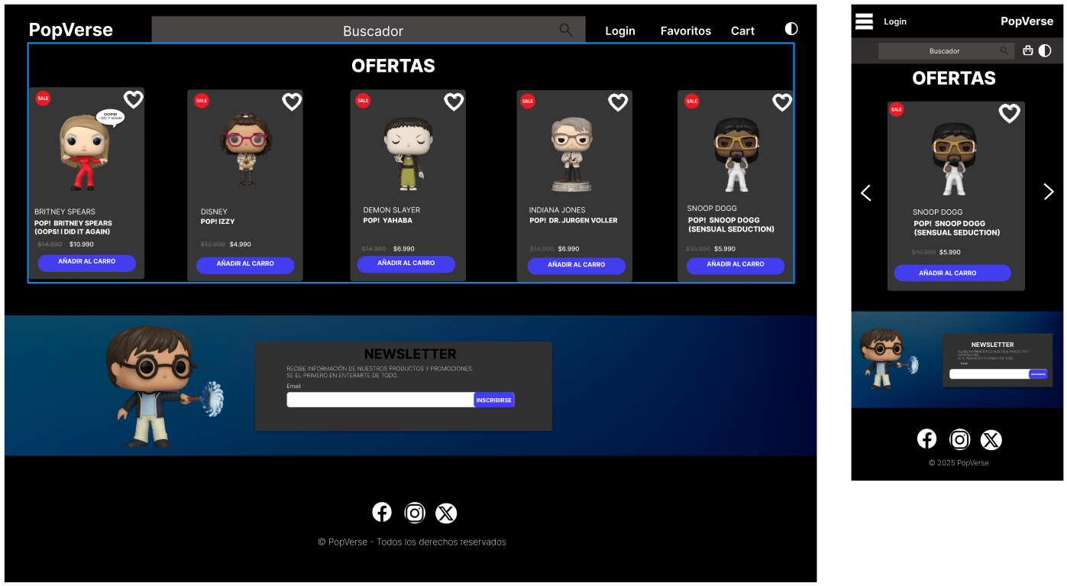
Screenshots - Home (Dark Mode)

Slide 8
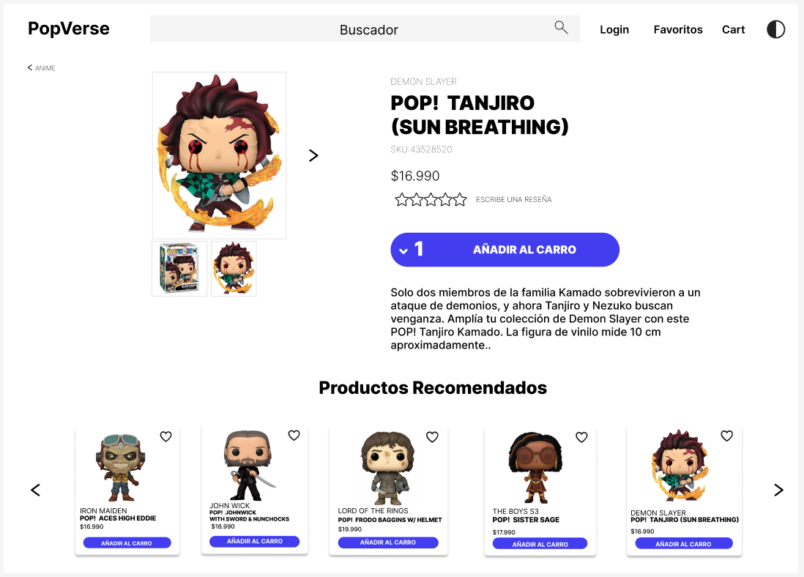
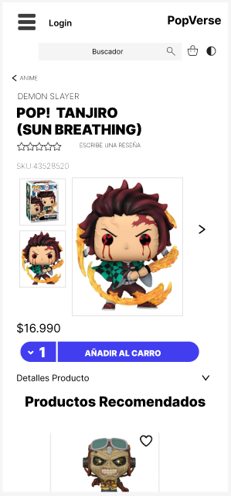
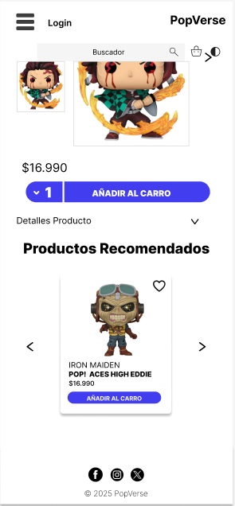
Screenshots - Product

Slide 9
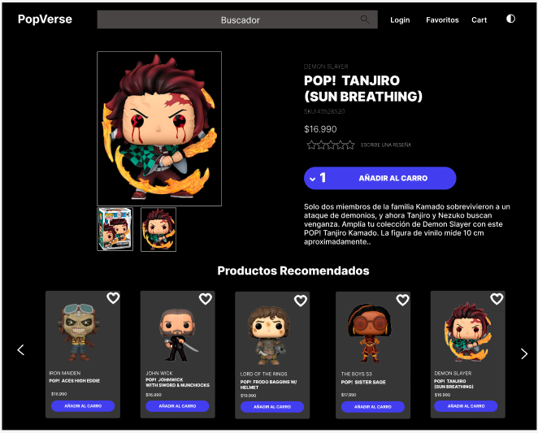
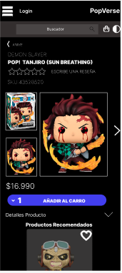
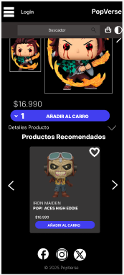
Screenshots - Product (Dark Mode)

Slide 10
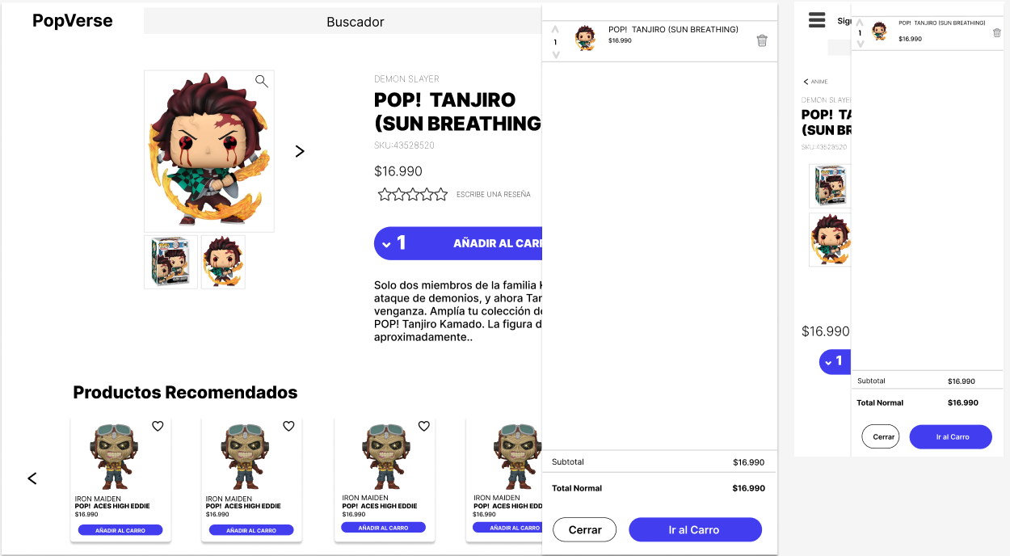
Screenshots - Carrito

Slide 11
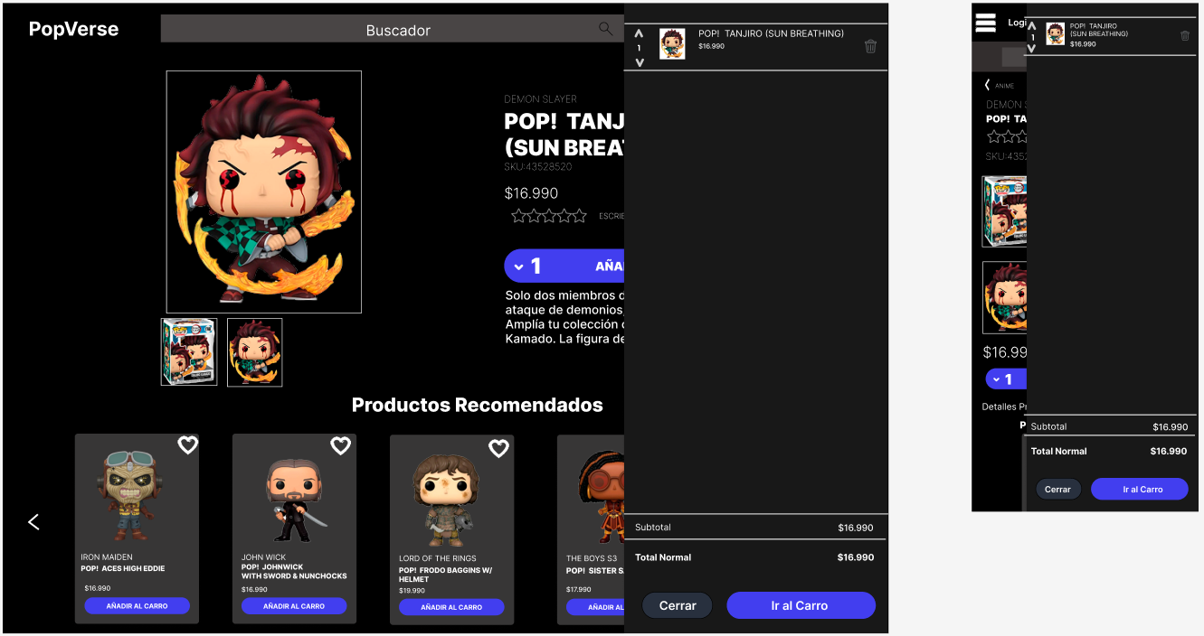
Screenshots - Carrito (Dark Mode)

Slide 12
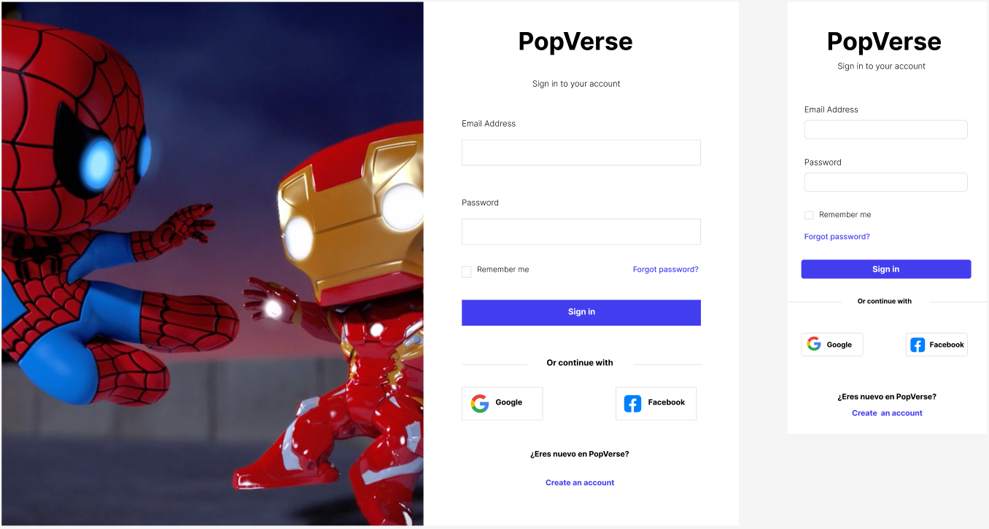
Screenshots - Login

Slide 13
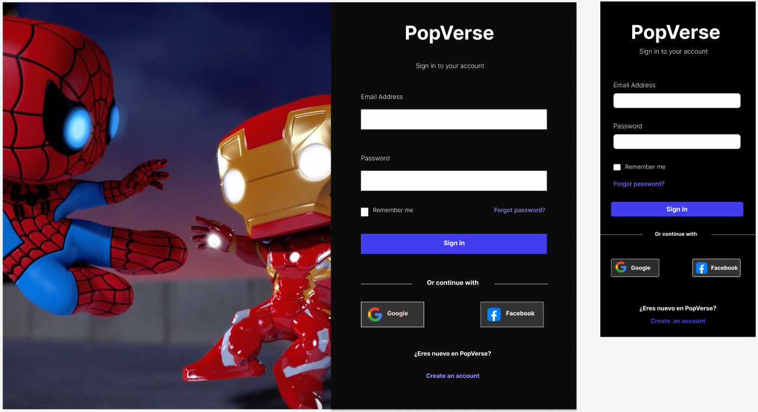
Screenshots - Login (Dark Mode)

Slide 14
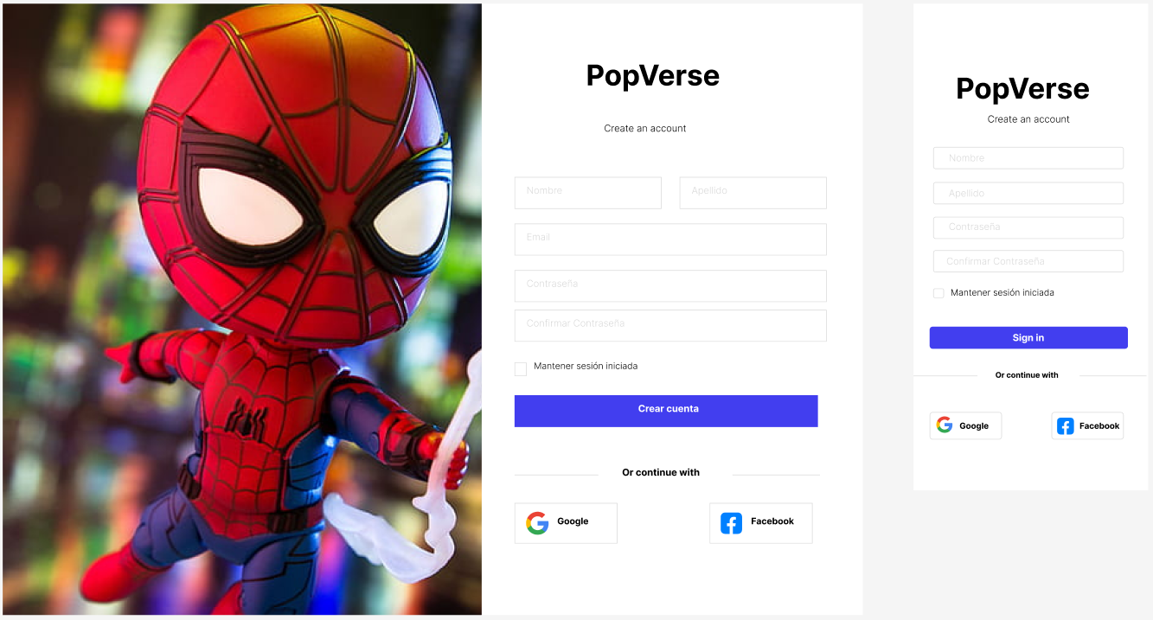
Screenshots - Register

Slide 15
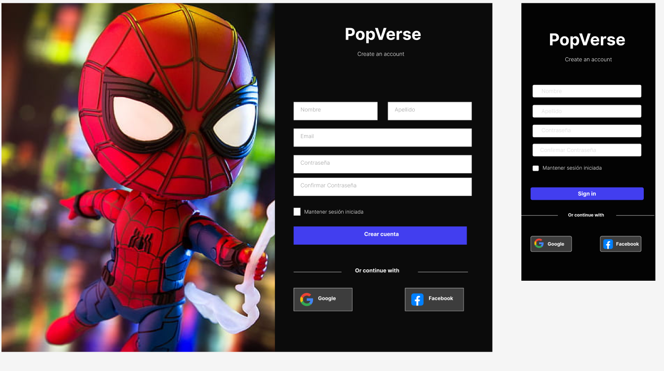
Screenshots - Register (Dark Mode)

Slide 16
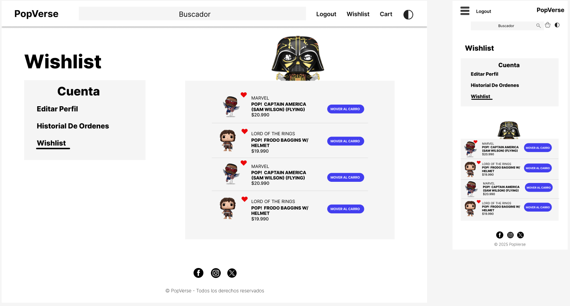
Screenshots - Wishlist

Slide 17
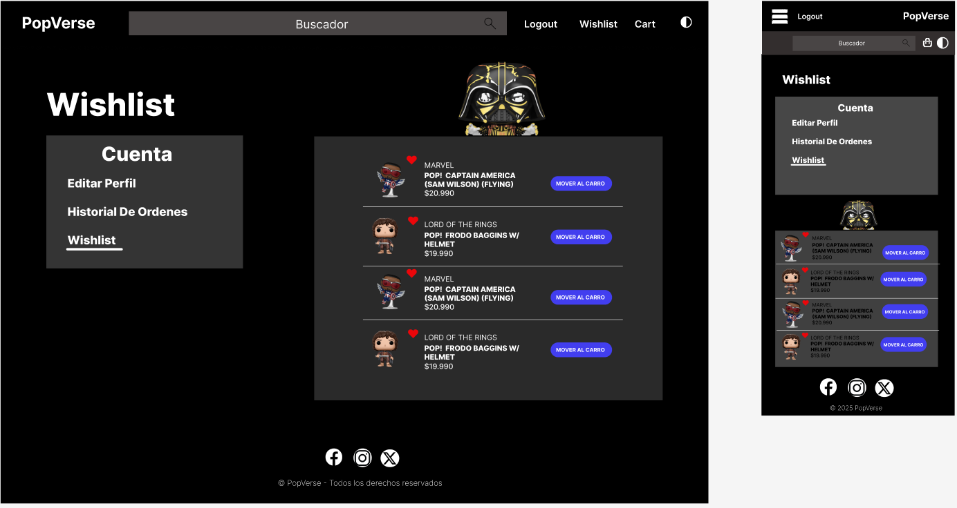
Screenshots - Wishlist (Dark Mode)

Slide 18
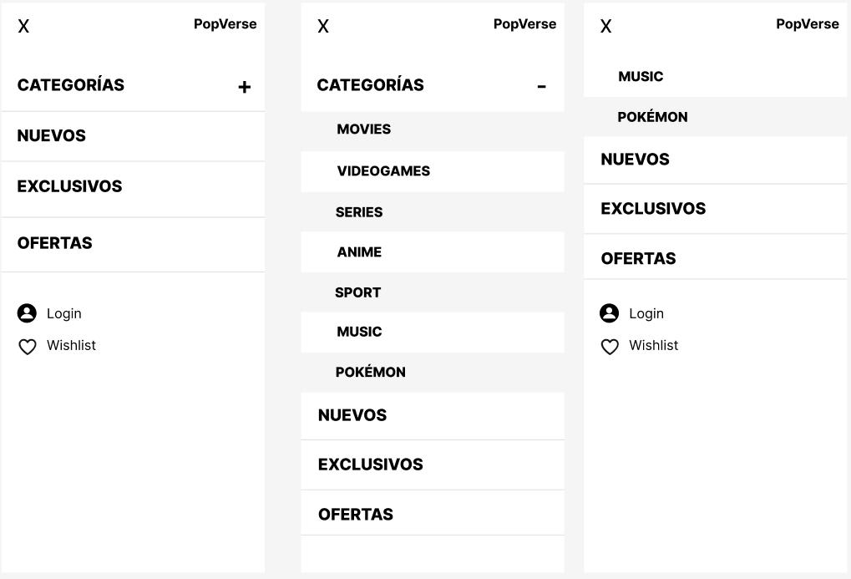
Screenshots - Menu

Slide 19
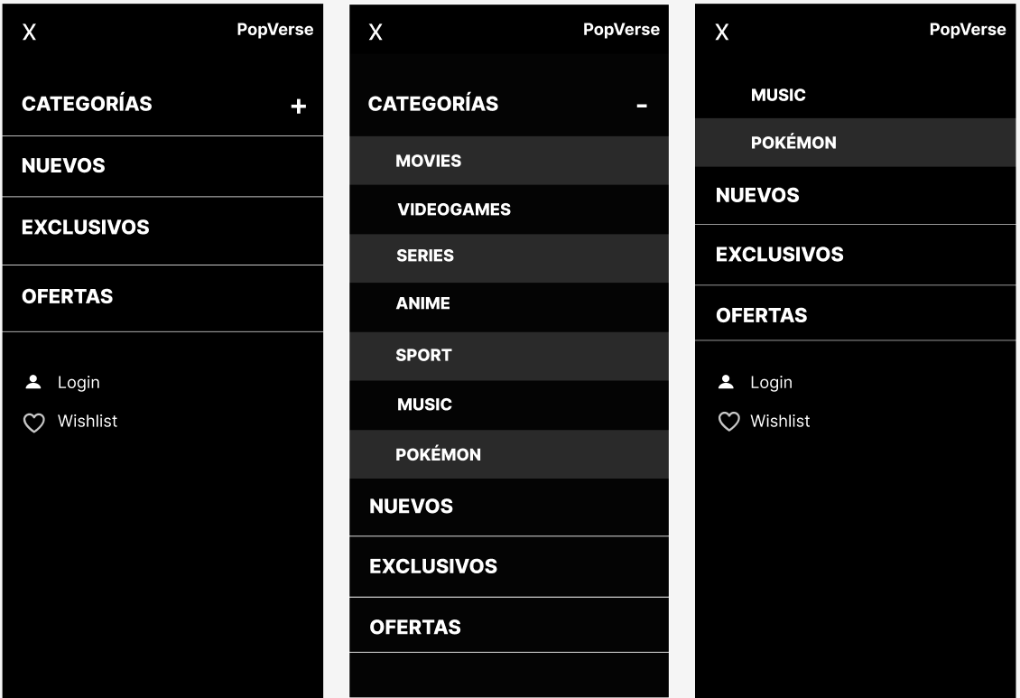
Screenshots - Menu (Dark Mode)

Slide 20
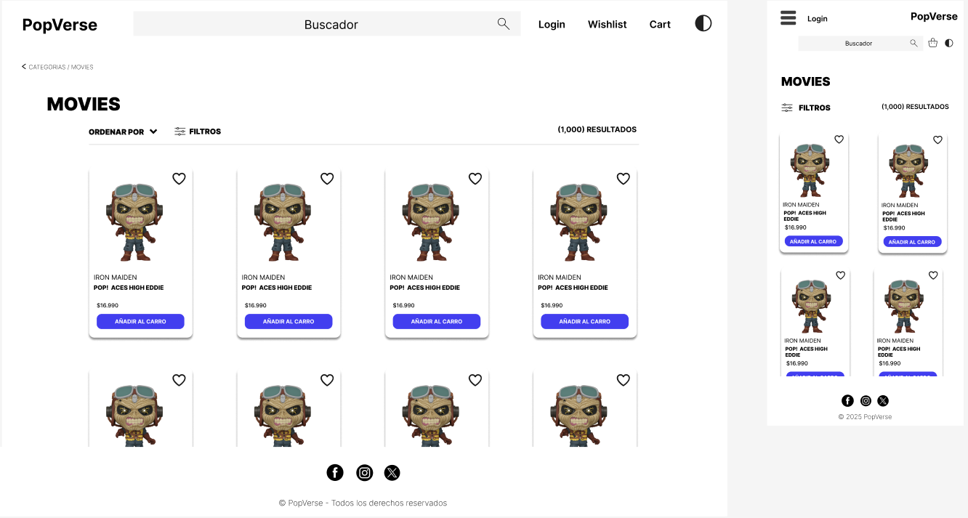
Screenshots - Categoría

Slide 21
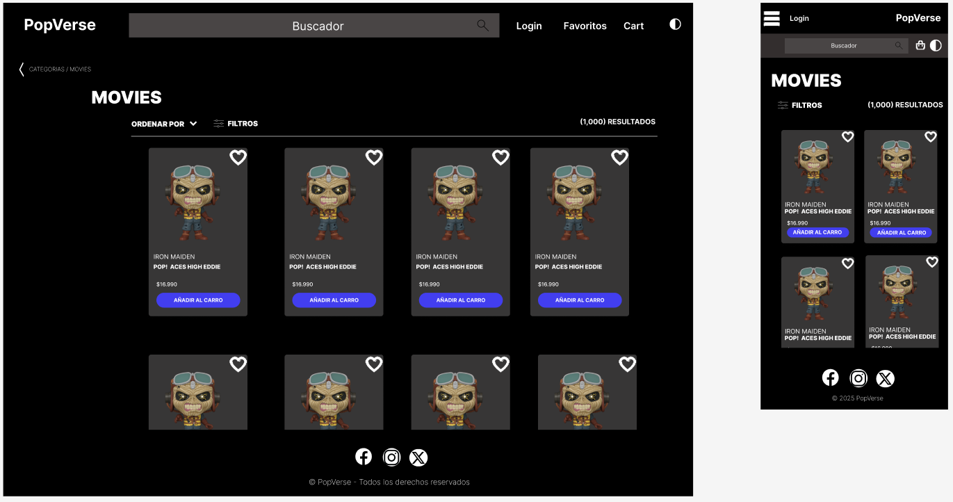
Screenshots - Categoría (Dark Mode)

